Slide 1

FILE MANAGEMENT

Slide 2
SAVING AND STORING FILES
The way files are saved and stored affects how easily they can be found later. There are two primary methods of file storage: local and cloud.
Local Storage: Files stored on the computer’s hard drive or external drives (e.g., USB sticks, external hard drives). They are accessible without an internet connection but can be lost if the device is damaged or lost.
Local storage advantages include quick access without needing an internet connection and direct control over the device’s contents.

Slide 3
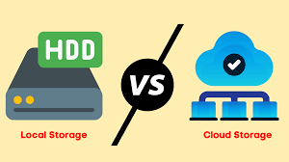

Slide 4

FILES SECURITY
Managing files also means protecting them. Security involves protecting files from unauthorized access or damage.
Password Protection: For sensitive documents, using passwords or encryption adds a layer of security. Many applications (like Microsoft Office) allow password protection for files.

Slide 5

Access Control: Setting permissions to control who can view, edit, or share files, especially in shared environments (e.g., Teams, Google Drive).
Antivirus Software: Using reliable antivirus programs ensures files are safe from malware or viruses that might corrupt or steal data.

Slide 6
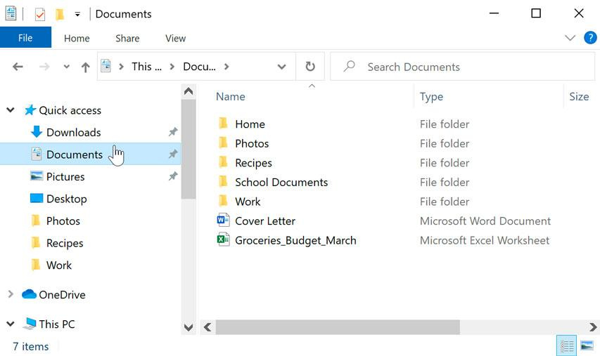
SEARCHING AND RETRIEVING FILES
The ability to search and retrieve files efficiently is key to good file management.
Search Functionality: Operating systems and cloud platforms come with search tools that allow users to search for files by name, file type, or modification date.

Slide 7

Tags and Metadata: Some systems allow users to tag files with keywords or add metadata. This can help in narrowing down search results quickly.
File Preview: Many file management systems (like Windows File Explorer or cloud platforms) allow users to preview a file without opening it fully, which can save time.

Slide 8
SEARCHING OF FILES
Windows:
Open File Explorer and click on the search bar in the top-right corner.
Start typing the name of the file, and Windows will search through all your folders for matching files.
Mac:
Open Finder and use the search bar at the top-right corner.
Type the name of the file, and Finder will show matching results across your system.

Slide 9

SHARING FILES
Sharing files is an essential part of digital work, whether it’s sending a document to a colleague or collaborating on a project.
Email Attachments: Files can be sent via email as attachments, but be mindful of file size limits (e.g., email services may restrict attachments over 25MB).
Cloud Sharing: Cloud services like Google Drive, OneDrive, or Dropbox allow users to share links to files or folders, with specific permissions for editing or viewing.

Slide 10
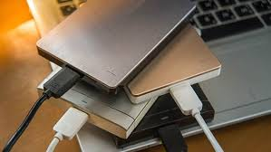
BACKUP OF FILES
Backing up files is crucial to prevent loss of important data due to accidental deletion, system failure, or theft.
Manual Backups: Copying important files to an external storage device like an external hard drive or USB stick.

